Slide 1
Need of Collection Framework
momedaram

Slide 2
Java Variables
Variables are containers for storing data values.
String name = "momedaram"; // stores String values
int rollNumber = 123; //stores integers without decimals.
float age = 20.6f; // stores floating point numbers, with decimals ex. 10.99 or -10.99
char gender = 'M’; // stores single characters, such as 'a' or 'B'.
boolean isGraduate = true; //boolean - stores values with two states: true or false

Slide 3
Suppose a class contains 100 students , and we want to store their roll numbers , we need 100 separate variables for storing the roll numbers
int rollNumber1 = 01; int rollNumber2 = 02; int rollNumber3 = 03; . . . . int rollNumber100 = 100;
Arrays are used to store multiple values in a single variable, instead of declaring separate variables for each value.
int[] rollNumbers = {01, 02,03,04 ......... 100}

Slide 4
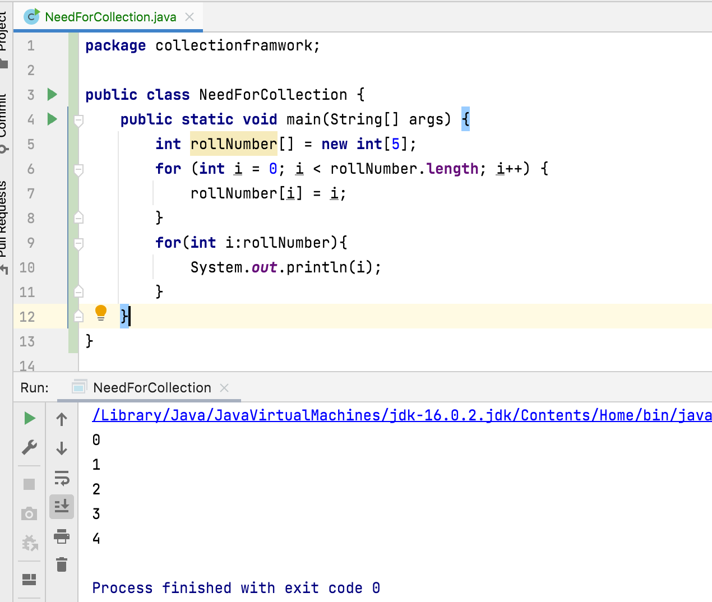
How can we handle a group of elements?
We can use arrays to store group of elements and handle them easily.

Slide 5
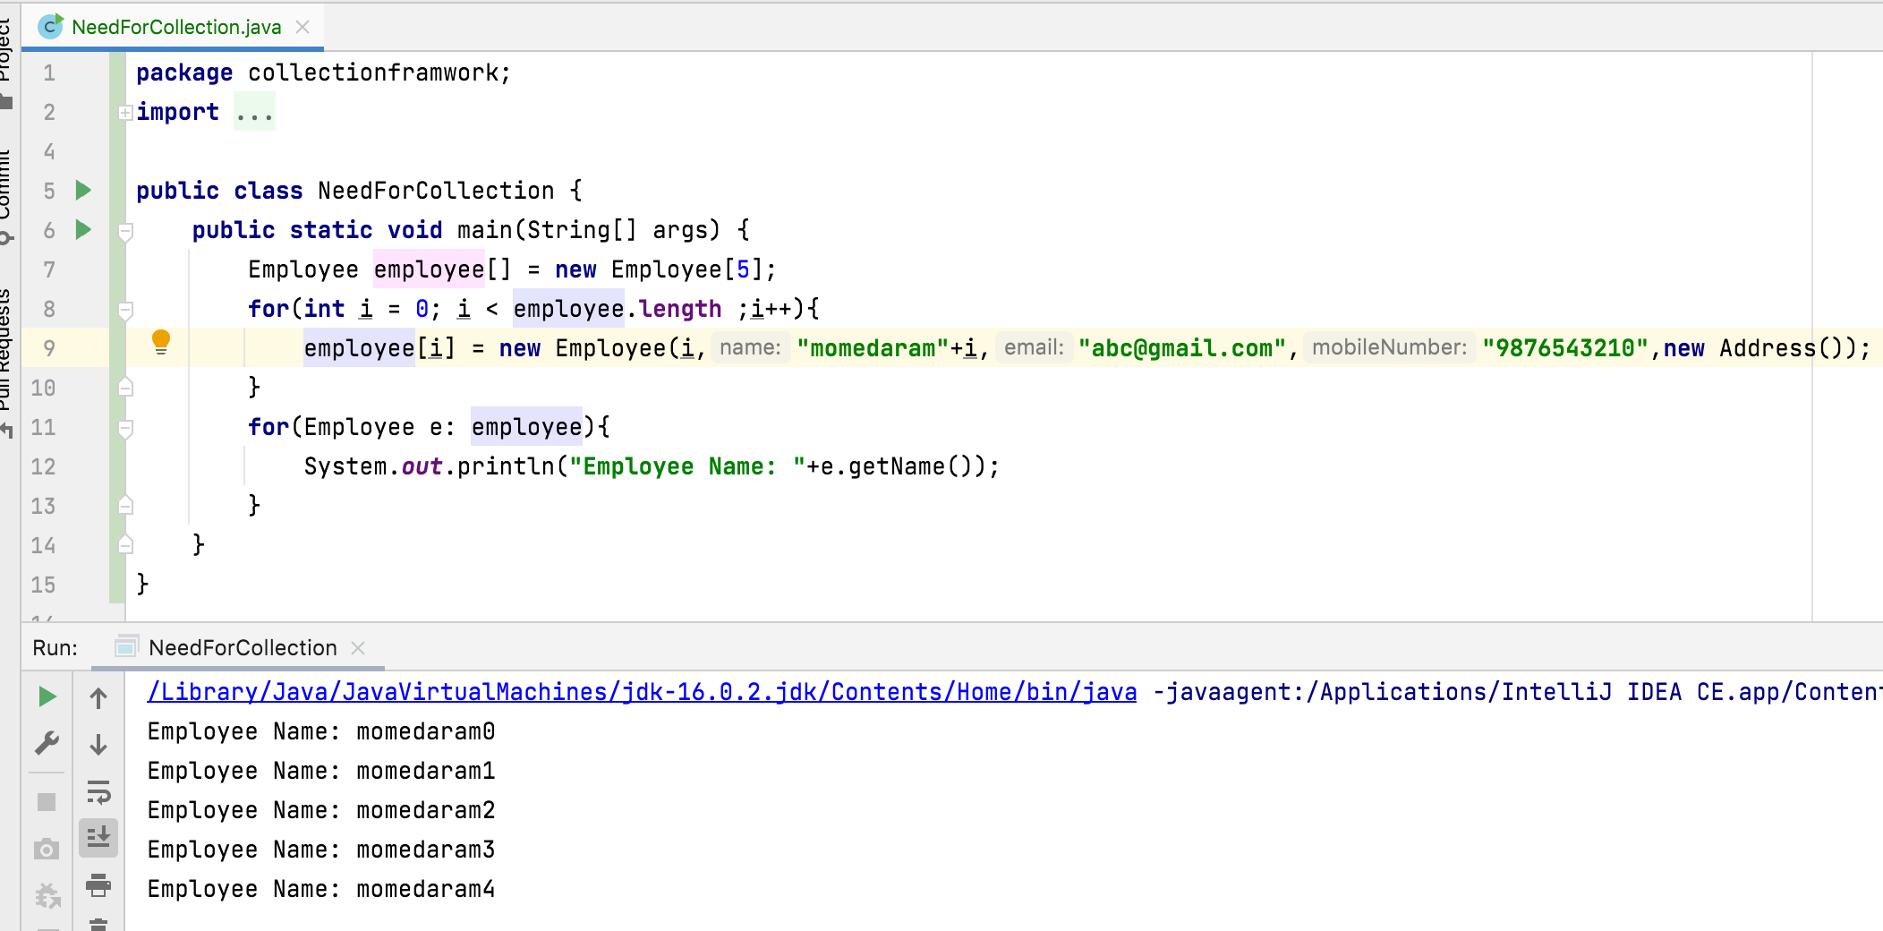
How can we handle a group of Objects?
We can use arrays to store group of objects and handle them easily.

Slide 6
Consider we have created array with size 1000 to store 1000 Students details but we got only 100 student details.
Consider we have created array with size 1000 to store 1000 Students details but we got 1100 student details.
Arrays are fixed in size i.e., once the array is created , its size is fixed (its size can’t be increased or decreased )

Slide 7
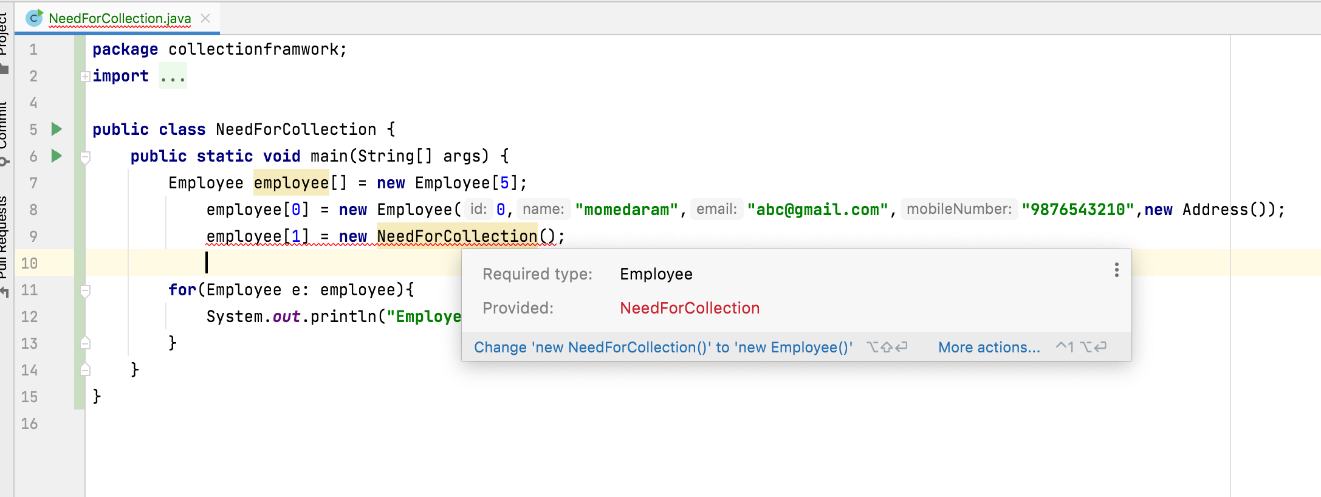
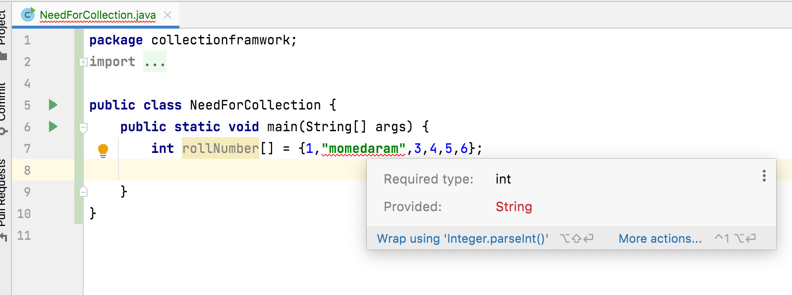
We can’t store different class objects into the same array. The reason is that an array can store only one type of elements. (Homogeneous )

Slide 8
If we want to store elements in an array, based on some sorting order ?
Search a particular element is available in array or not ?
if we want to process the array elements , there are no methods available to carry out this. (No inbuilt methods available)

Slide 9
Limitations of Arrays:
Arrays are fixed in size i.e., once the array is created , its size is fixed (its size can’t be increased or decreased )
We can’t store different class objects into the same array. The reason is that an array can store only one type of elements. (Homogeneous )
if we want to process the array elements , there are no methods available to carry out this. (No inbuilt methods available)
Due to these problems, programmers want a better mechanism to store a group of objects.
That Mechanism is Collections.

Slide 10
Thank You !
momedaram

